Slide 1
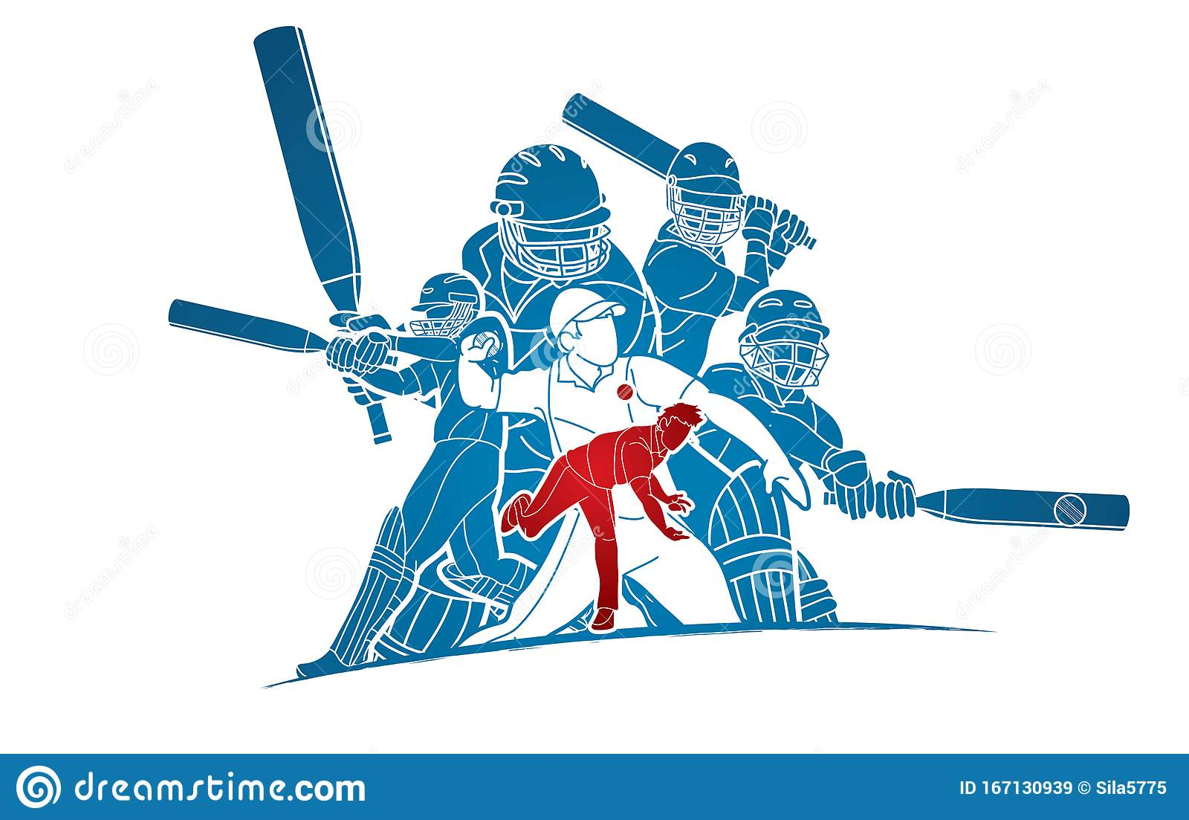
Fantasy league Team - 15
Apuru Rohan (098)
Srinivas Reddy(113)
Pavan kumar(090)
Sagar amruth(066)

Slide 2
ABSTRACT
This is a prediction game guided with Graphical User Interface. This can be used/played by anyone who has basic cricket knowledge. The user must register himself and verify himself with his g-mail account. The user will be given 500 points for registering himself. The user should select the available matches. The user should invest his points on the options given. The user has freedom to invest his money on both the options for the given question. If his options are correct then his points will be doubled otherwise his invested points on the question will be halved. The project has an admin login through which the admin sets the match between the teams competing and feeds the answer for the question after the match has completed. The leaderboard positions will be shown with all the registered users irrespective of the participation. The questions are quite simple, like more run getters, more wickets etc., among the players shown as options.
This project is developed to provide fun of betting without investing a penny. We came across this project looking at various advertisements during the Indian premier league. For doing this project, we gained some basic knowledge about GUI programming in python. The package tkinter is used in this project, it will provide the required GUI.

Slide 3
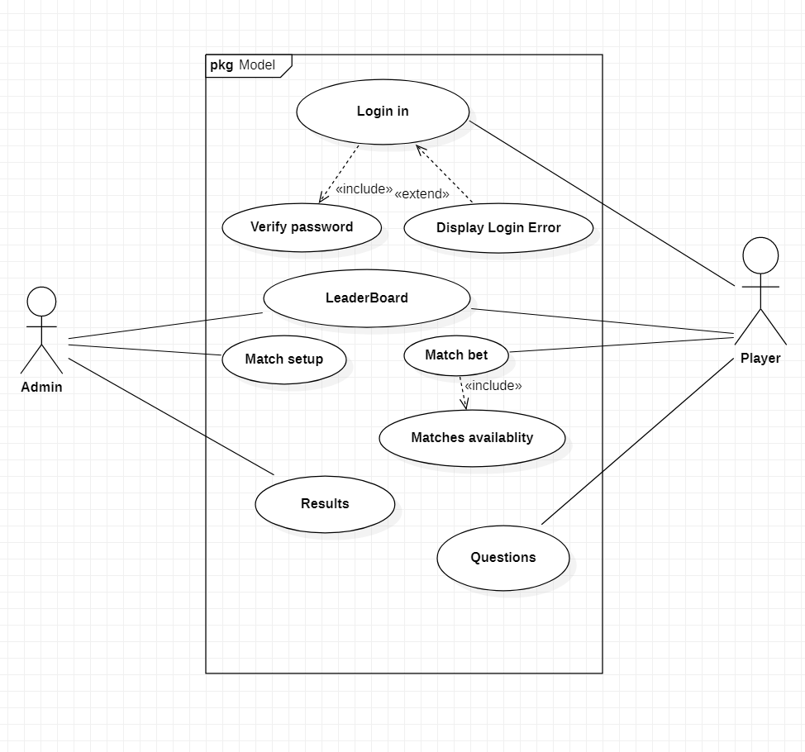
Use case diagram

Slide 4
TECHNOLOGY USED
Hardware Requirements
512 MB RAM
2GB HDD
CORE i5
Software Requirements
Windows XP/ Windows 2000
PYTHON INTERPRETER

Slide 5
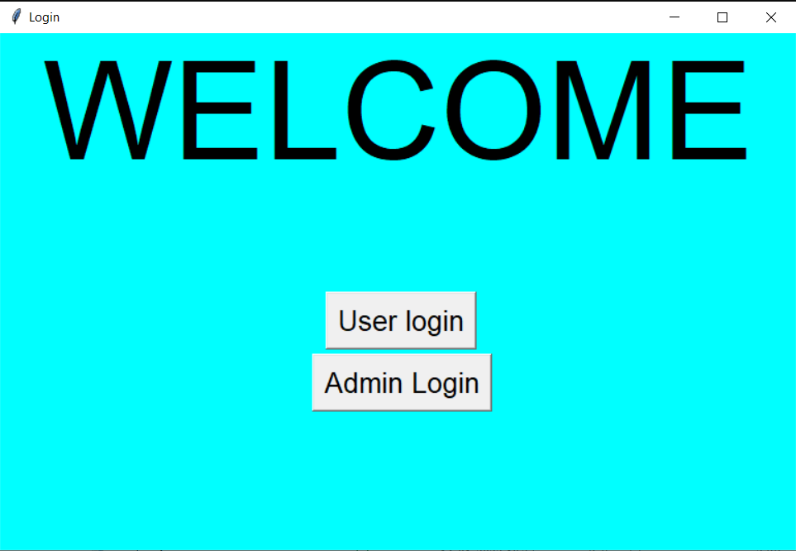
SCREENSHOTS OF EXECUTION

Slide 6
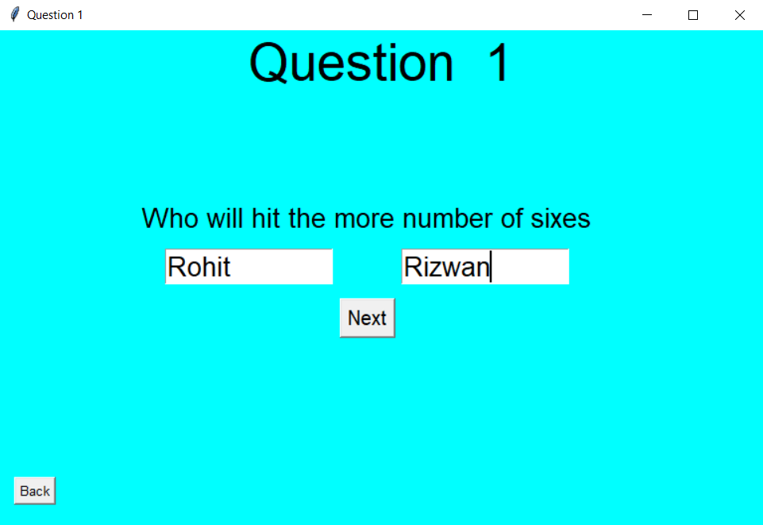
ADMIN FOR SETTING UP THE MATCH

Slide 7
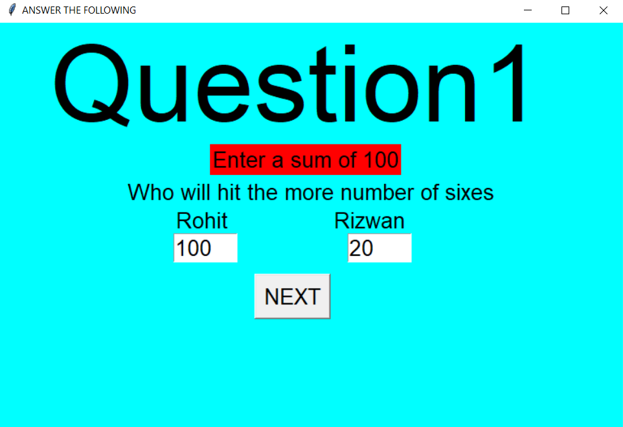
USER WILL ANSWERING

Slide 8
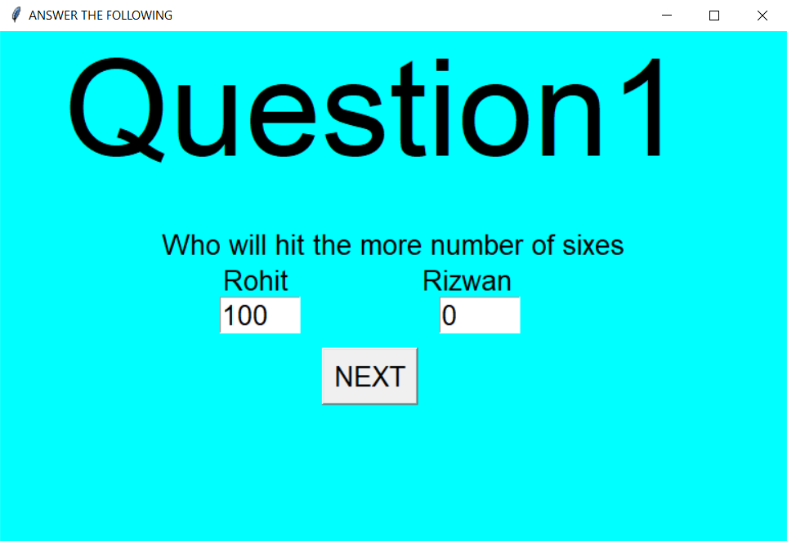
ADMIN DECIDING THE WINNERS

Slide 9
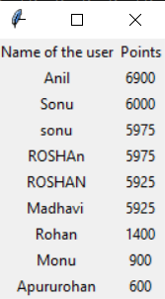
LEADERBOARD

Slide 10
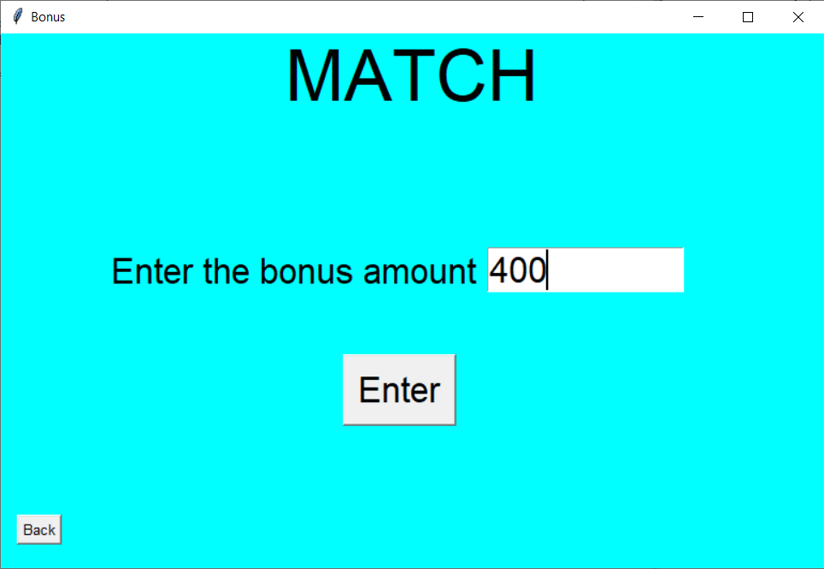
ADMIN GIVING BONUS

Slide 11


CONCLUSION AND FUTURE WORK
The user can connect through his Facebook account and play contests with his friends.
To include the data on to a database and make it a kind of a mobile app.
This app may be extended for football events.
In addition, the user may invest real money into it and get some coupons in return.

Slide 12


